Slide 1
neutron@esprit:$
Greetings humans

Slide 2
neutron@esprit:$
whoami
Pi-group: Neutron
Membres:
Ouerfelli Mohamed
Khlifi Mohamed Naceur
Sabta Ruqaia
Guirat Melek
Cheffi Rabii
Kamoun Aymen
Belakhel Mohamed

Slide 3
neutron@esprit:$
sudo apt install
openstack_in_depth
Reading package lists… Done
Reading dependency tree… Done
Reading state information… Done
failed…

Slide 4

neutron@esprit:$
sudo apt install
openstack_in_depth
Reading package lists… Done
Reading dependency tree… Done
Reading state information… Done
Do you want to continue? [Y/n]
y
success
neutron@esprit:$
systemctl daemon-reload
neutron@esprit:$
systemctl start openstack
neutron@esprit:$
systemctl enable openstack

Slide 5
neutron@esprit:$
ops –d overview

Slide 6
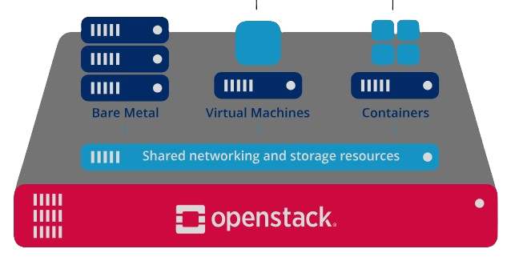







Slide 7

Iaas

Slide 8
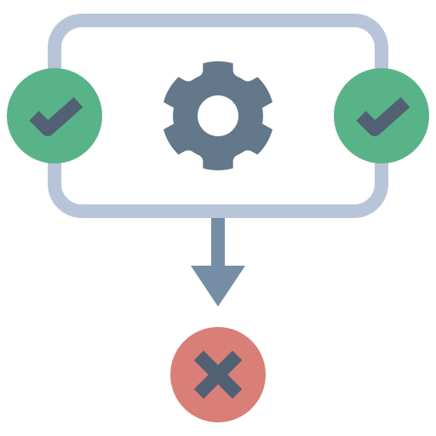
Iaas
Orchestration

Slide 9

Fault management
Iaas
Orchestration

Slide 11










Slide 12
neutron@esprit:$
ops components -l

Slide 13
Nova

Slide 15
Swift

Slide 17
Cinder

Slide 19
Neutron

Slide 21
Keystone

Slide 23
Glance

Slide 25
Heat

Slide 27
Horizon

Slide 29
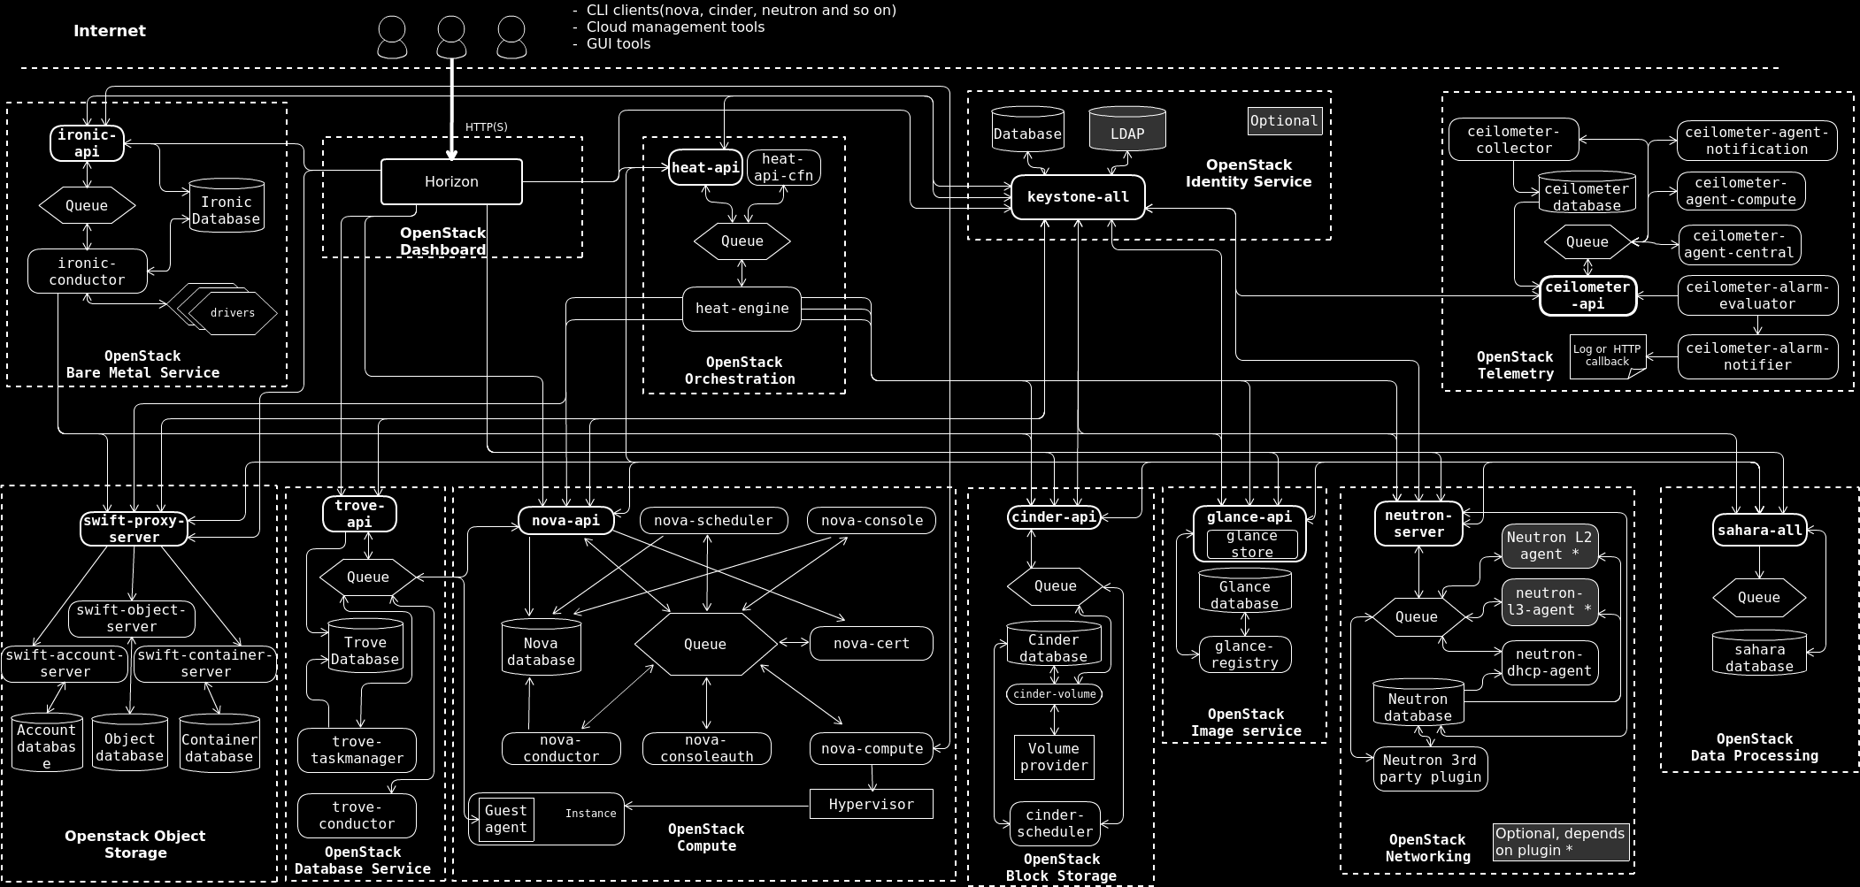
Ceilometer

Slide 30
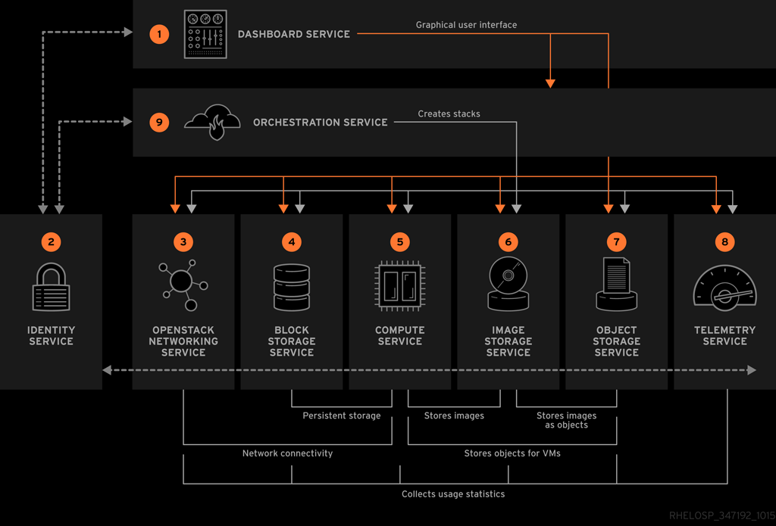
neutron@esprit:$
ops components relationship
https://docs.openstack.org/install-guide/_images/openstack-arch-kilo-logical-v1.png

Slide 31
neutron@esprit:$
tree openstack-components
-- Openstack | |-- Controller | |---- nova | |---- heat-api
| |---- horizon-web
| |---- ceilometer
| |---- neutron
| |---- cinder
| |---- glance-api
| |---- swift
| |---- keystone
|-- Compute
| |---- nova
| |---- neutron
| |---- ceilometer
|-- Storage
| |---- cinder
| |---- swift

Slide 32
neutron@esprit:$
tree openstack-components | grep nova
-- Openstack | |-- Controller | |---- nova-api | |---- nova-scheduler
| |---- nova-conductor
|-- Compute
| |---- nova-compute

Slide 33
neutron@esprit:$
tree openstack-components | grep glance
-- Openstack | |-- Controller | |---- glance-api
| |---- glance-registry

Slide 34
neutron@esprit:$
tree openstack-components | grep ceilometer
-- Openstack | |-- Controller | |---- ceilometer-api
| |-- Compute
| |---- ceilometer-agent-compute

Slide 35
neutron@esprit:$
tree openstack-components | grep neutron
-- Openstack | |-- Controller | |---- neutron-server
|
|-- Compute
| |---- neutron-linuxbridge-agent

Slide 36
neutron@esprit:$
tree openstack-components | grep cinder
-- Openstack | |-- Controller | |---- cinder-api
| |---- cinder-scheduler |
|-- Compute
| |---- cinder-volume

Slide 37
neutron@esprit:$
ops components relationship
https://access.redhat.com/webassets/avalon/d/Red_Hat_OpenStack_Platform-9-Architecture_Guide-en-US/images/fce6394275bd3444892c5d3a91ccf17c/RHEL_OSP_arch_347192_1015_JCS_01_Interface-Overview.png

Slide 41
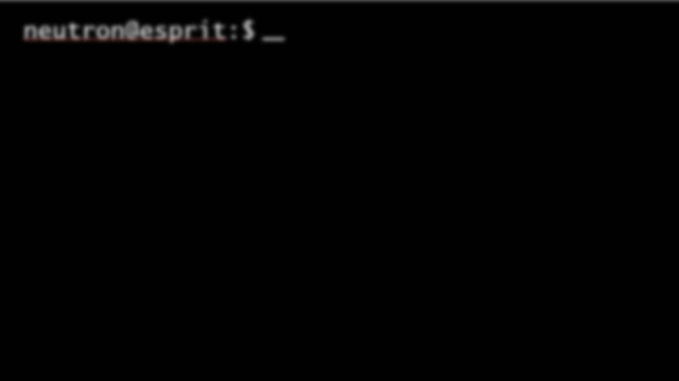
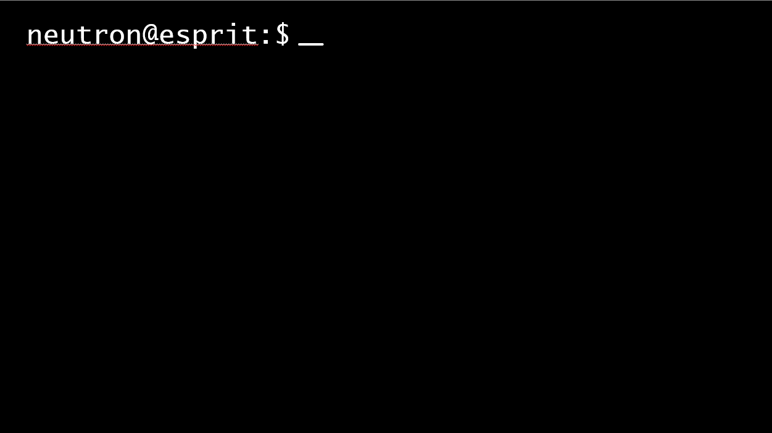
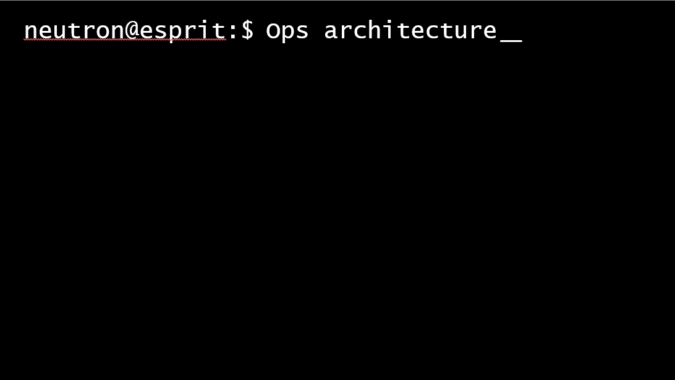

Slide 42
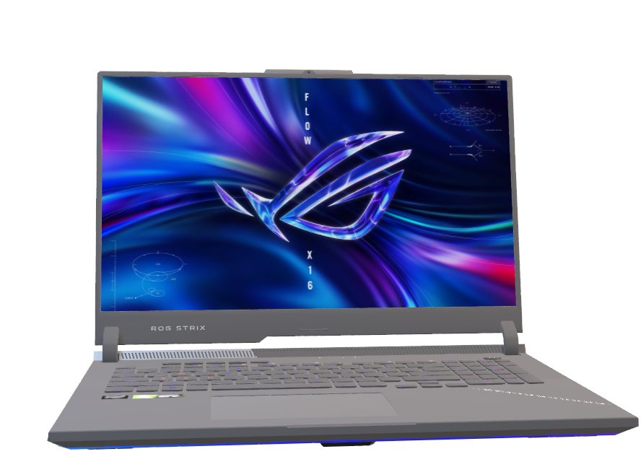
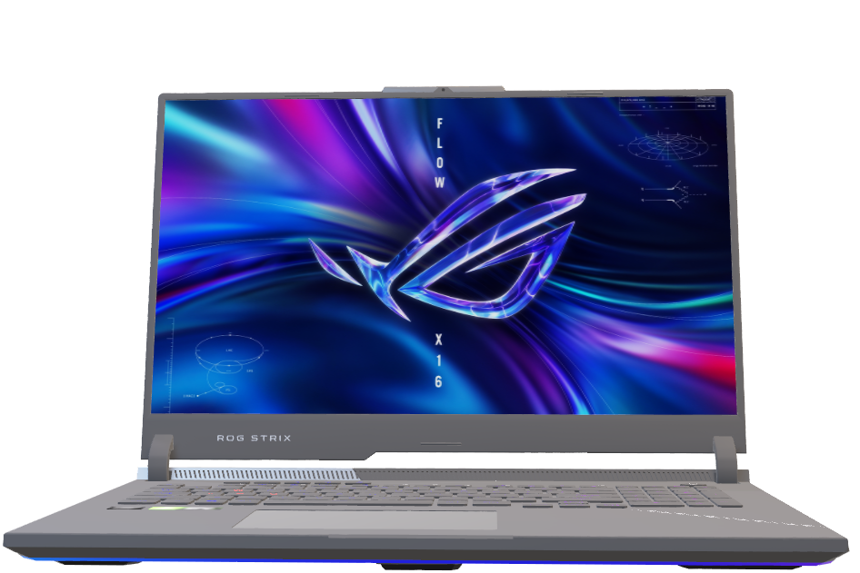
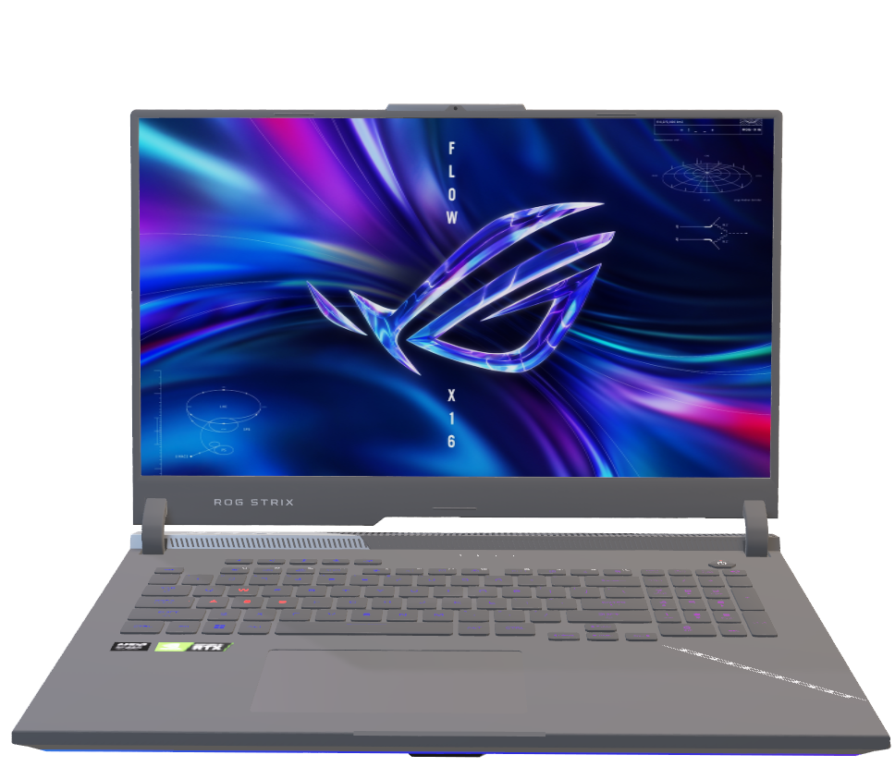
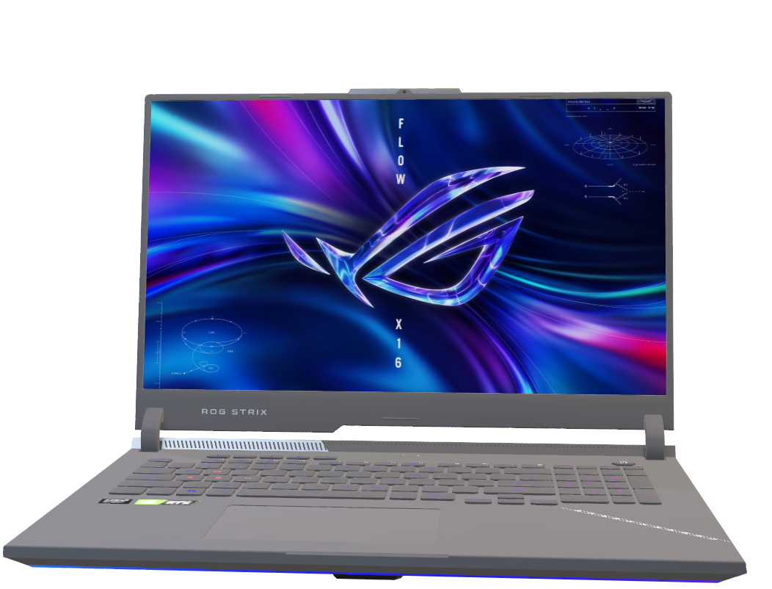
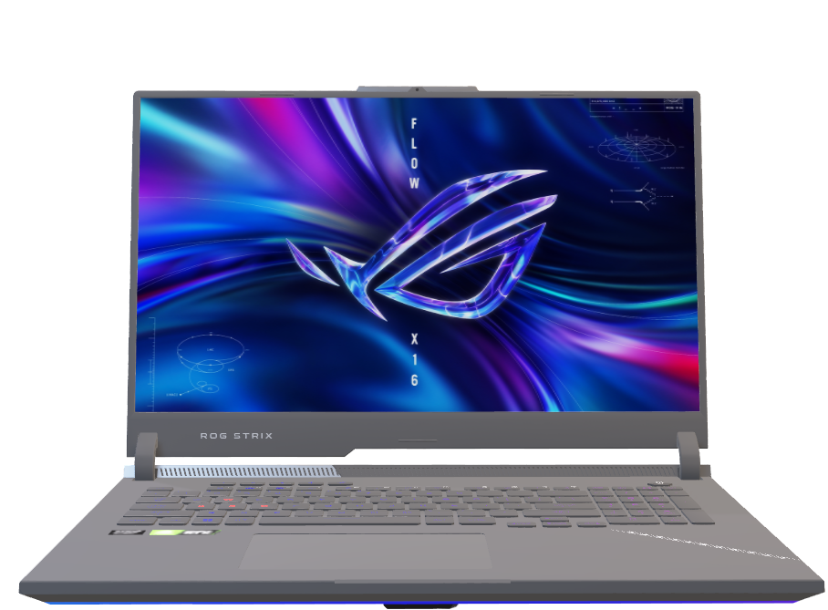
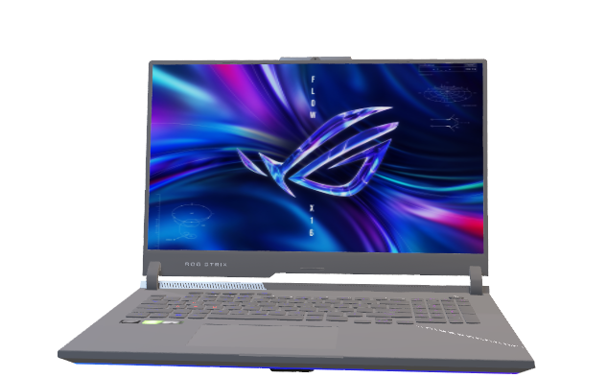
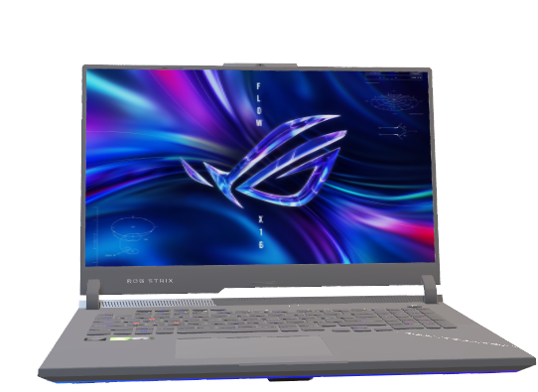

Slide 43
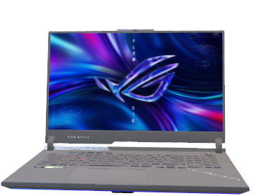






Controller node
Compute nodes
Storage nodes

Slide 44

neutron@esprit:$
sudo show controller node
Ruqaia’s pc:
CPU: i7-12700H
RAM: 32Go
Storage: 1T-SSD

Slide 45
Controller node
Compute nodes
Storage nodes

Slide 46
neutron@esprit:$
sudo show compute nodes
Mohamed’s pc Cpu:Ryzen5-4600H
RAM:24GB
Storage:1T+
128SSD
Mohamed’s pc Cpu:i5-10th RAM:16GB
Storage:512SSD
Naceur’s pc Cpu:Ryzen7-4800H
RAM:16GB
Storage:1T+
128SSD
Rabii’s pc Cpu:i5 12450H
RAM: 16GB
Storage: 512

Slide 47
Controller node
Compute nodes
Storage nodes

Slide 48
neutron@esprit:$
sudo show storage nodes
Aymen’s pc Cpu:i5-9th gen
RAM: 8GB
Storage: 2T + 512SSD
Melek’s pc
Cpu:i7 6700HQ
RAM: 24GB
Storage: 1TSSD

Slide 49
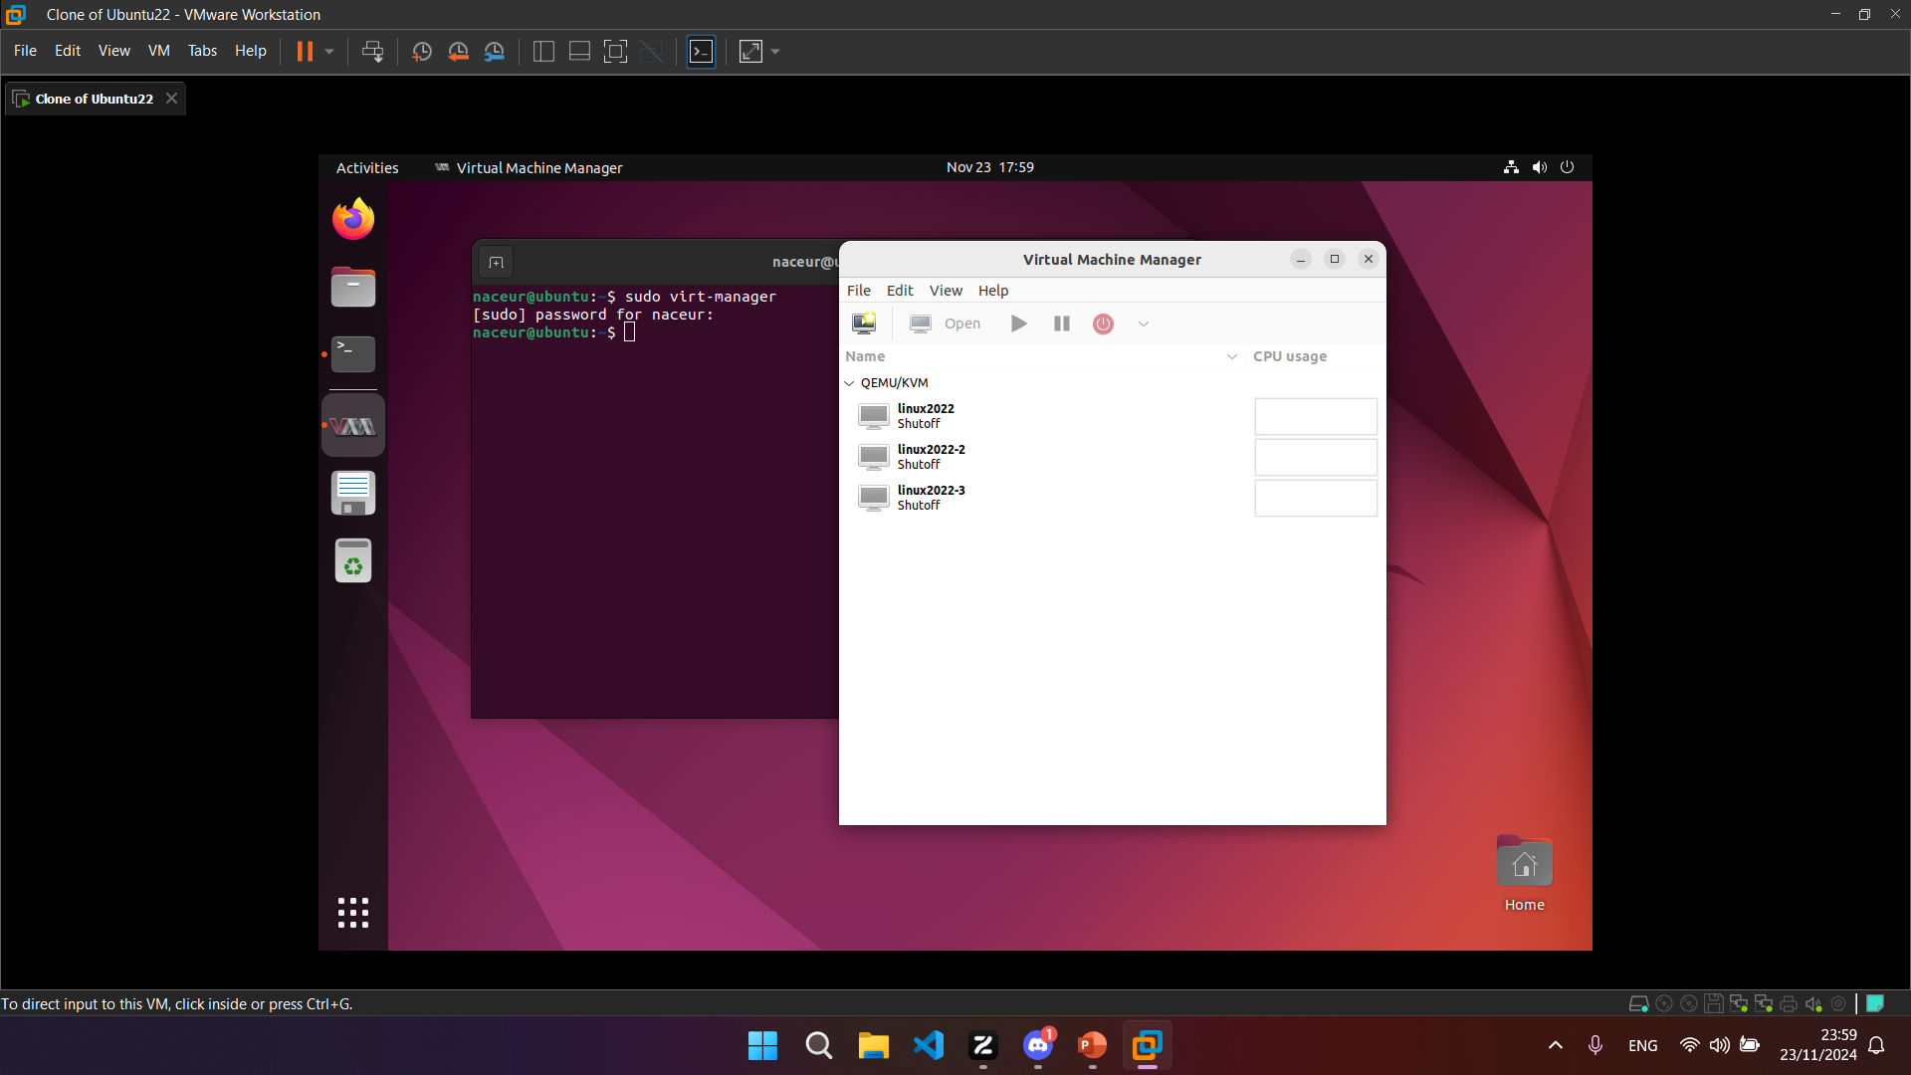
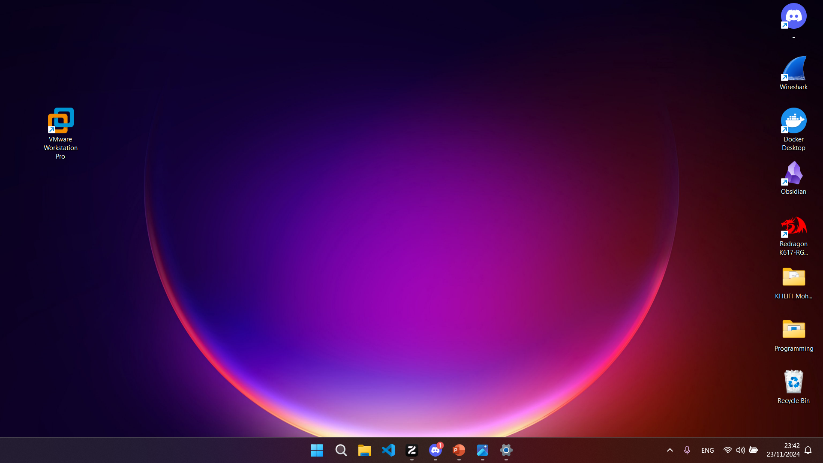


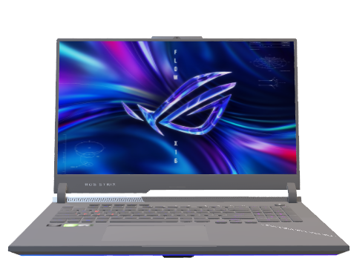
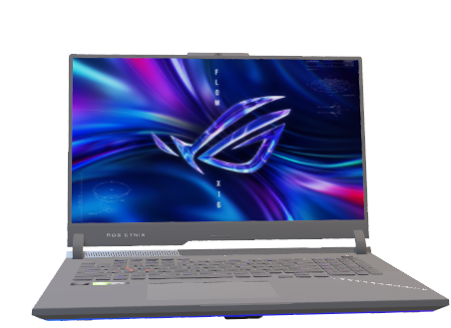

Slide 50
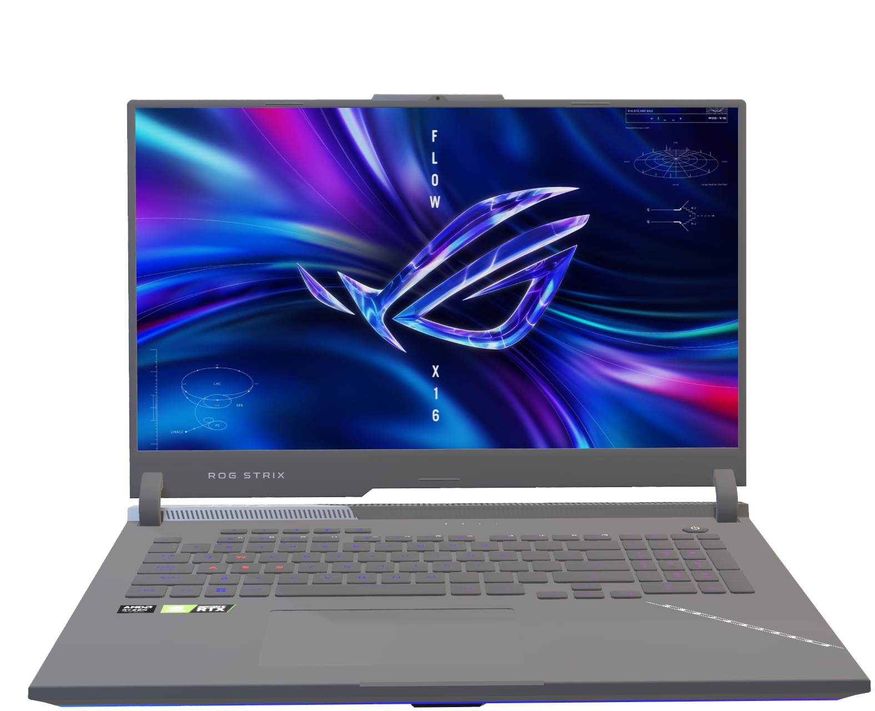

Slide 51
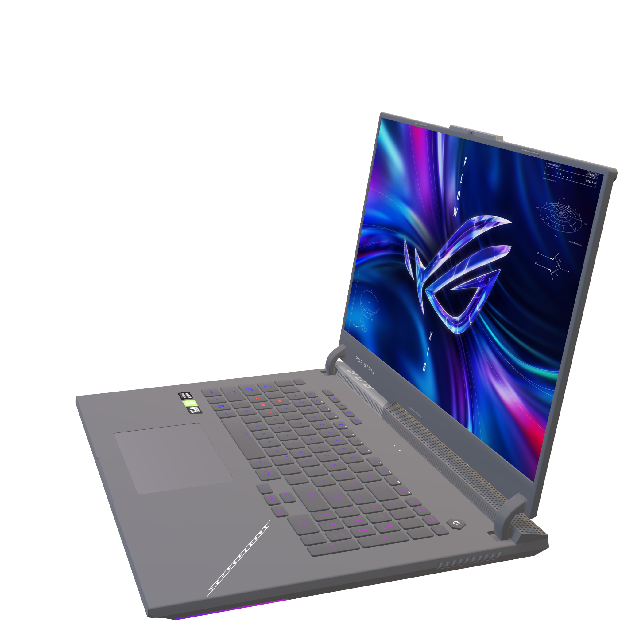

Slide 52


Slide 53
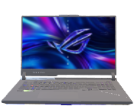



Infrastructure Layer
Hypervisor Layer: Vmware
Workstation pro
Hardware Layer

Slide 54
Infrastructure Layer
Hypervisor Layer: Vmware
Workstation pro
Hardware Layer

Slide 55

KVM (compute nodes)
Infrastructure Layer
Hypervisor Layer: Vmware
Workstation pro
Hardware Layer

Slide 56
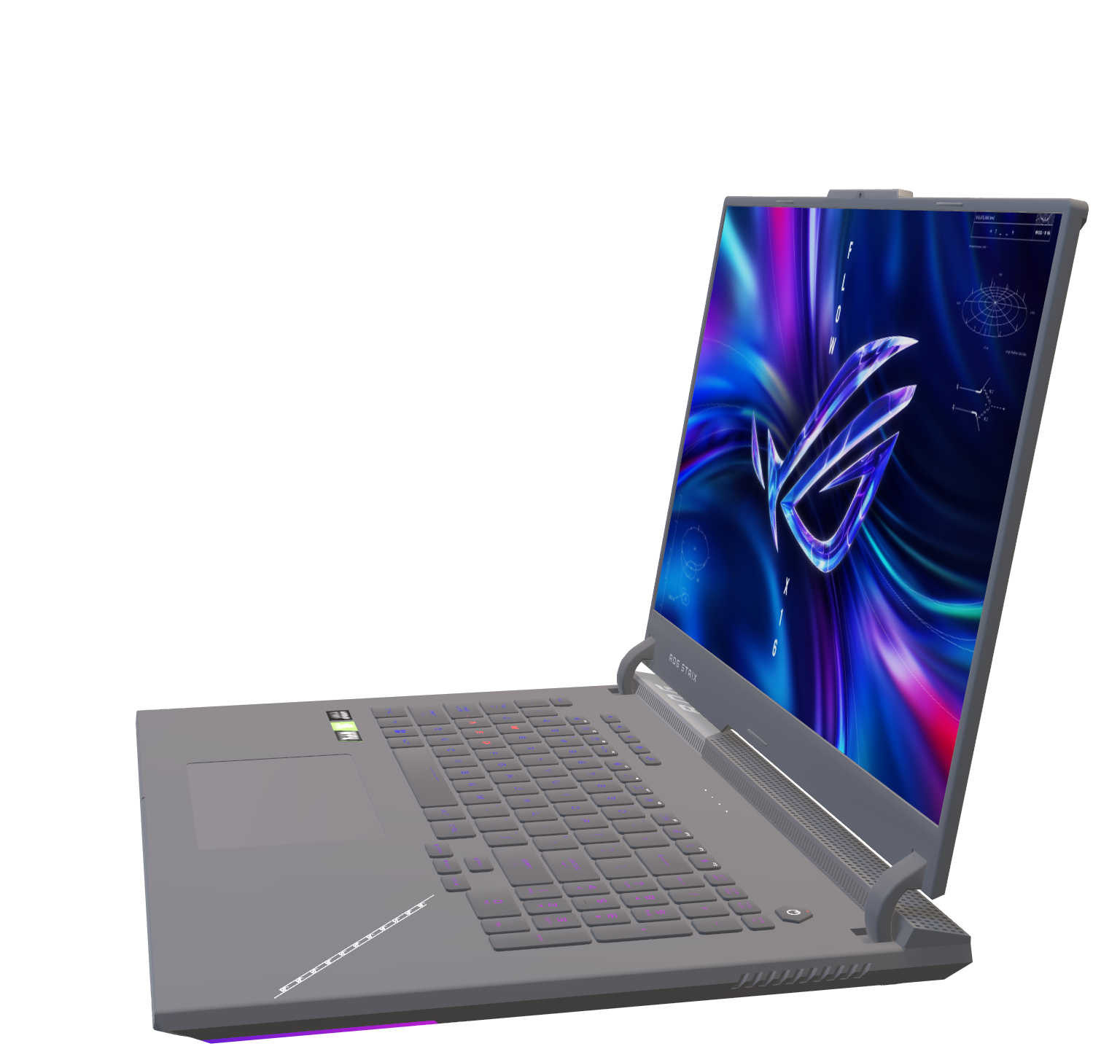

Slide 57
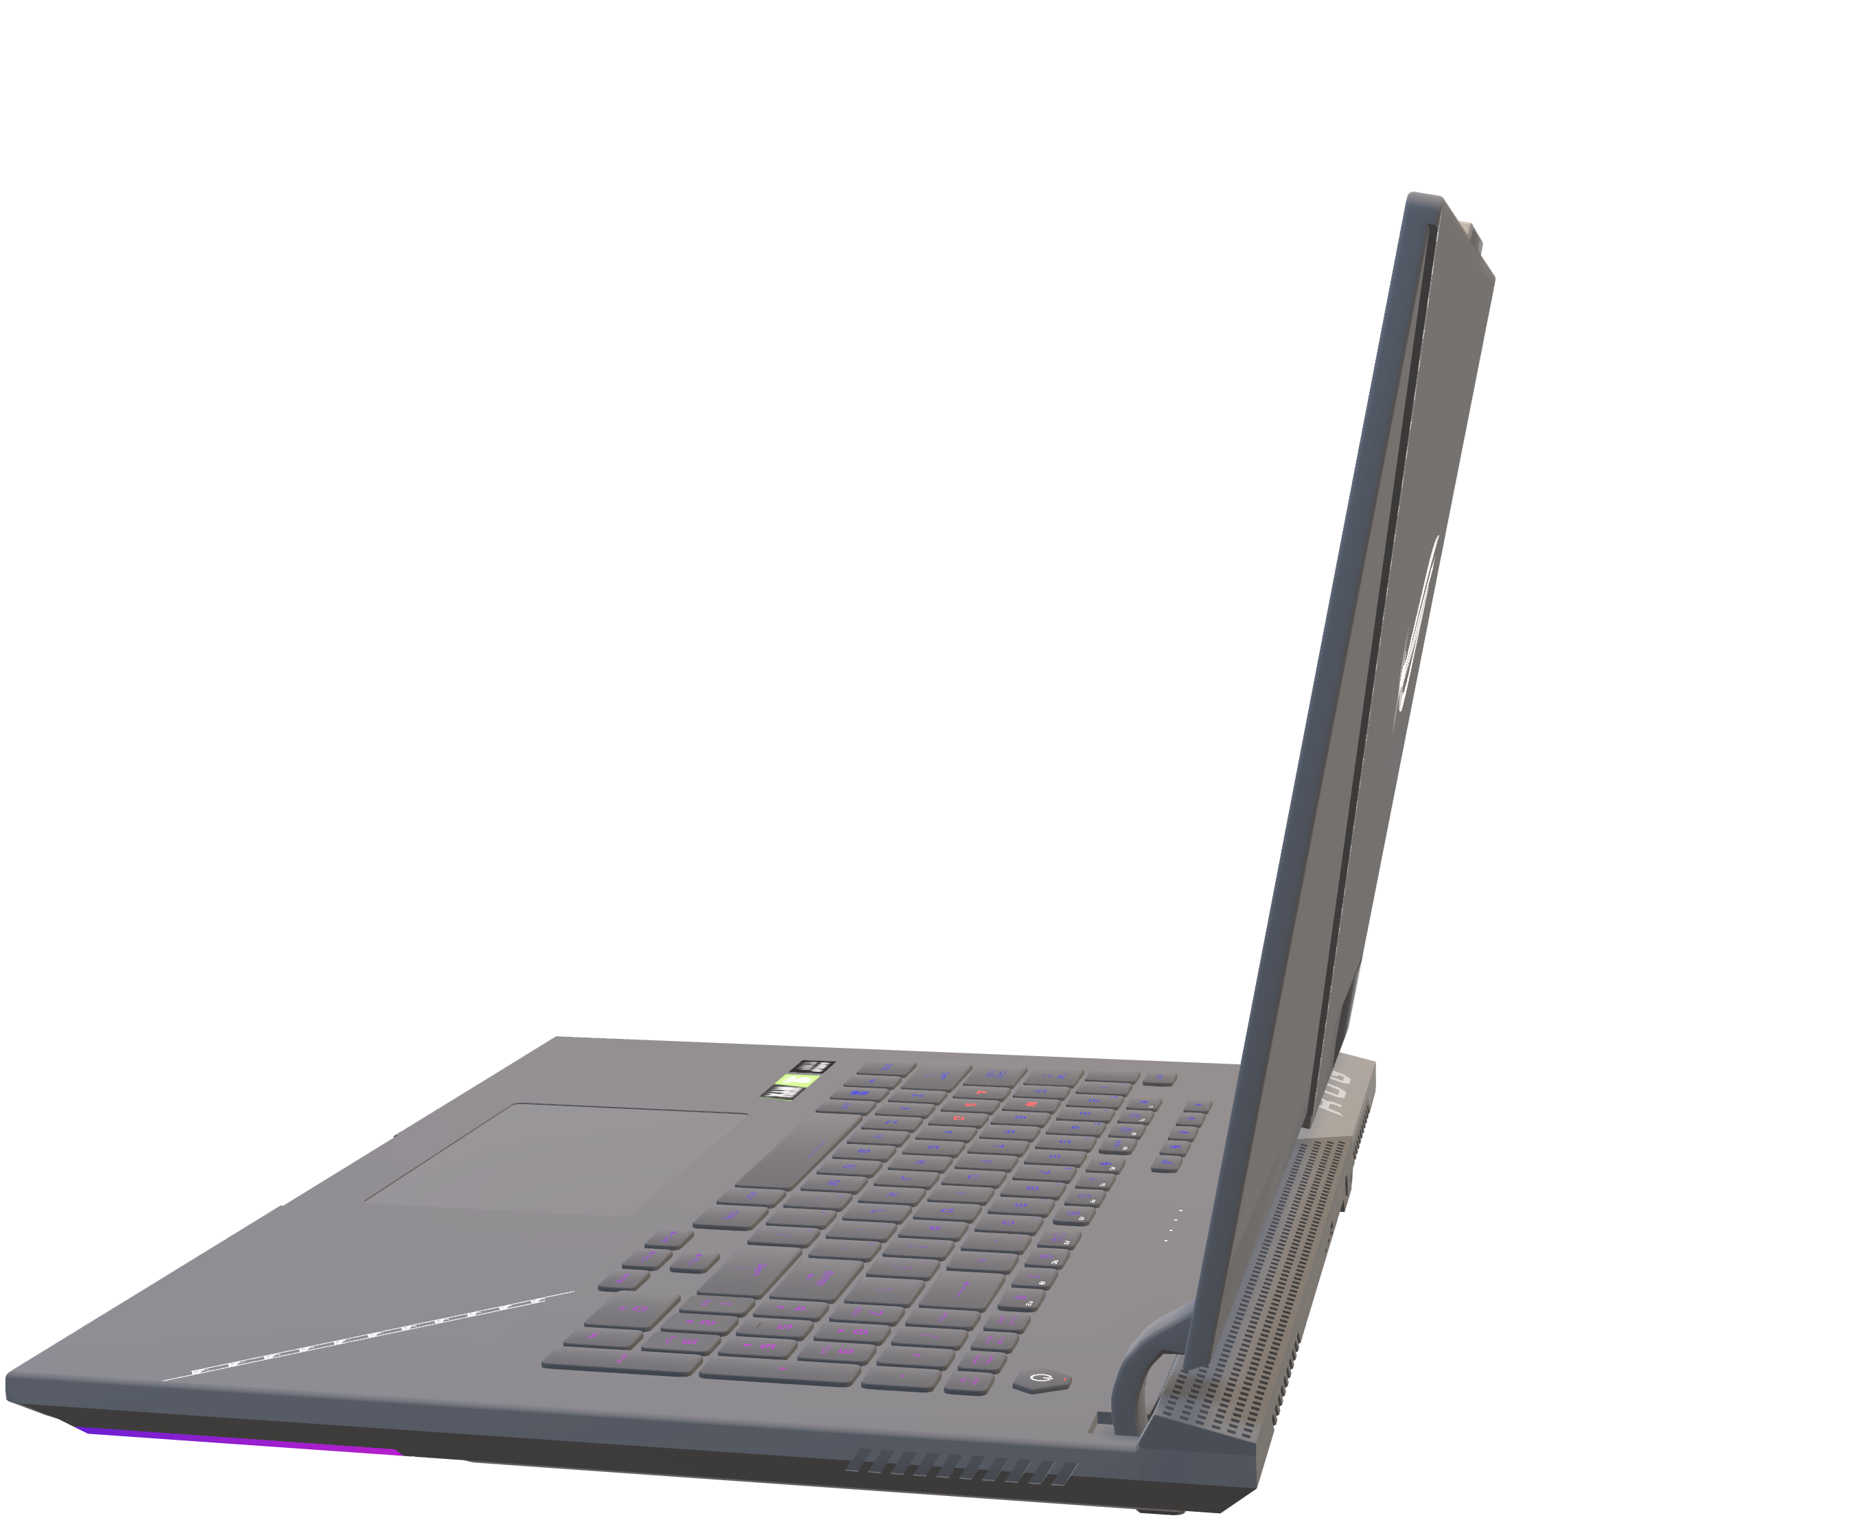

Slide 58
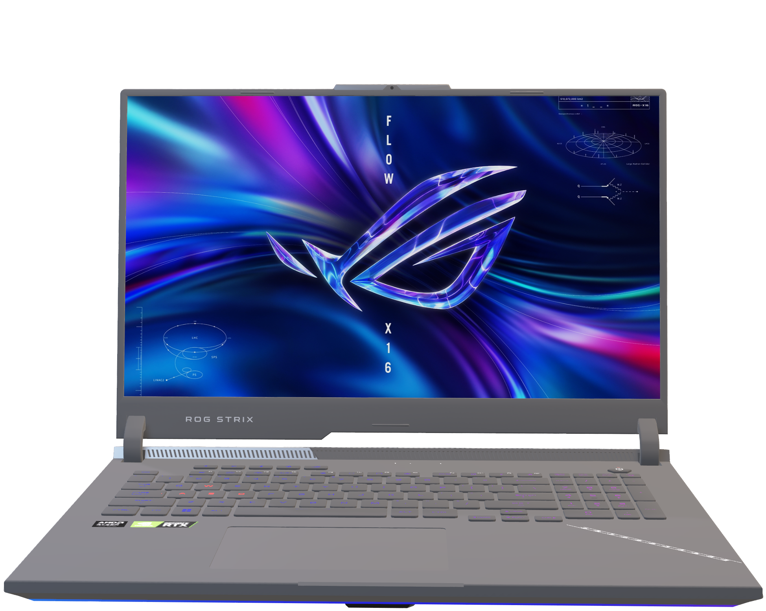

Slide 59
Compute nodes
Controller node
Storage nodes

Slide 60
neutron@esprit:#
show controller components

Slide 61
controller components
optional
Mandatory
https://docs.openstack.org/nova/2024.2/install/overview.html#example-architecture

Slide 62
Compute nodes
Controller node
Storage nodes

Slide 63
neutron@esprit:#
show compute components
https://docs.openstack.org/nova/2024.2/install/overview.html#example-architecture

Slide 64
Compute nodes
Controller node
Storage nodes

Slide 65
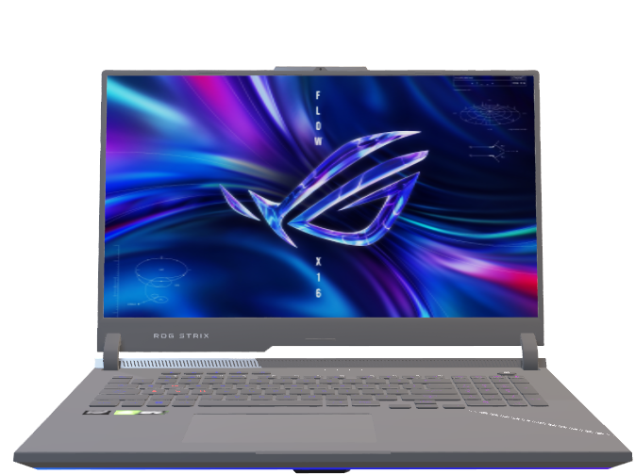
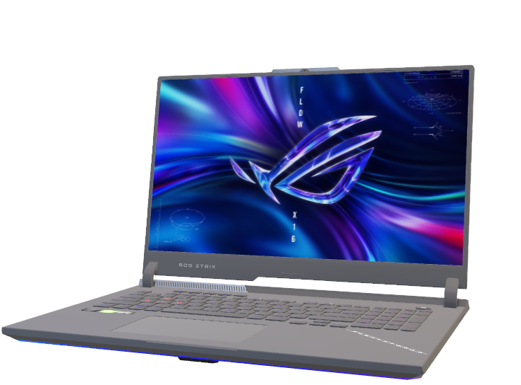
neutron@esprit:#
show storage components
KVM (compute nodes)
https://docs.openstack.org/nova/2024.2/install/overview.html#example-architecture

Slide 66


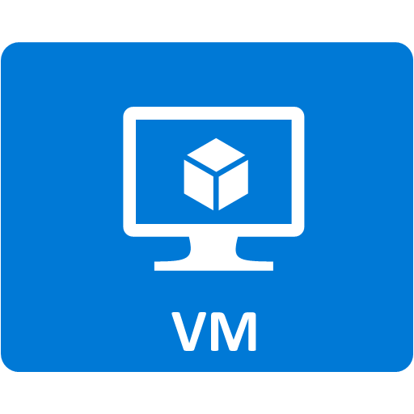
Virtual machines
KVM (compute nodes)
Infrastructure Layer
Hypervisor Layer: Vmware
Workstation pro
Hardware Layer

Slide 67

Virtual machines

Slide 68

Containerization
Virtual machines
KVM (compute nodes)
Infrastructure Layer
Hypervisor Layer: Vmware
Workstation pro
Hardware Layer

Slide 69
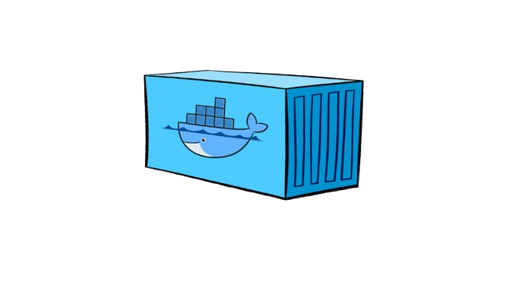

Slide 70
????

Slide 71

:))))))

Slide 72
Orchestration
Containerization
Virtual machines
KVM (compute nodes)
Infrastructure Layer
Hypervisor Layer: Vmware
Workstation pro
Hardware Layer

Slide 73

Master Node
Worker Node
Worker Node
API server
Kubelet
Kubelet
Scheduler
Kube-proxy
Kube-proxy
Controller Manager
Pod 1
Pod 2
Pod 1
Pod 2
etcd
CCM
Container runtime
Container runtime

Slide 74
Pod 1
Pod 2

Slide 75
Configuration management
Orchestration
Containerization
Virtual machines
KVM (compute nodes)
Infrastructure Layer
Hypervisor Layer: Vmware
Workstation pro
Hardware Layer

Slide 76

monitoring
visualization

Slide 77
Monitoring
Configuration management
Orchestration
Containerization
Virtual machines
KVM (compute nodes)
Infrastructure Layer
Hypervisor Layer: Vmware
Workstation pro
Hardware Layer

Slide 78
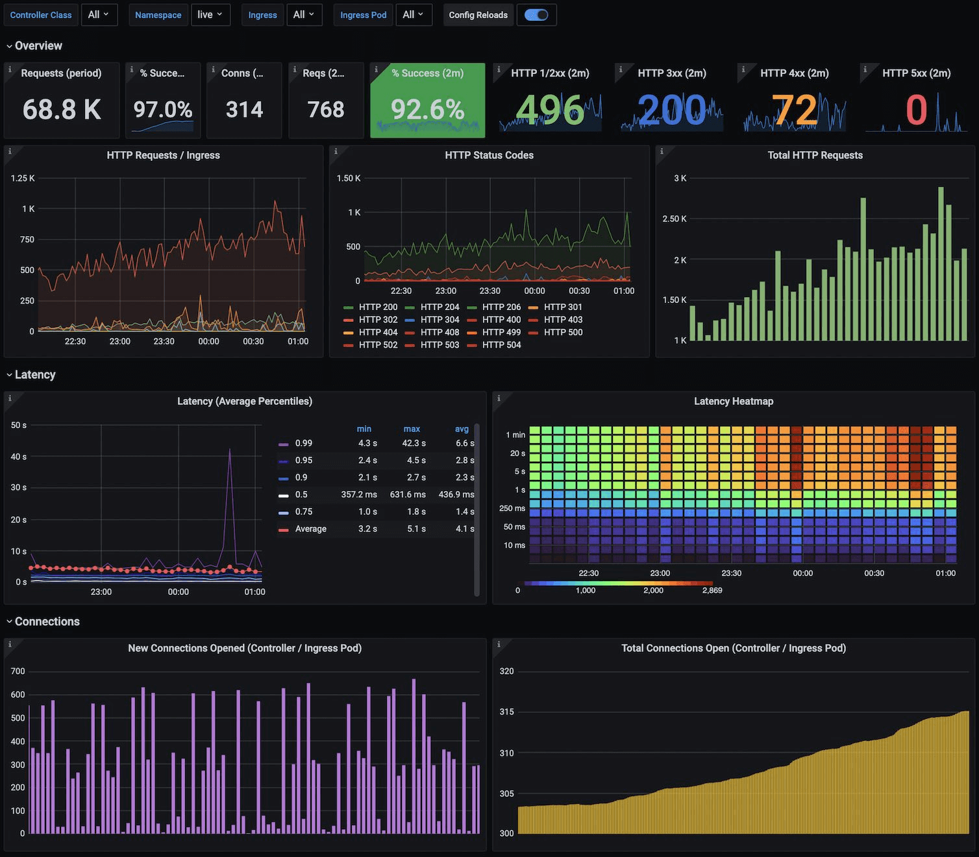

Slide 79
Monitoring
Configuration management
Orchestration
Containerization
Virtual machines
KVM (compute nodes)
Infrastructure Layer
Hypervisor Layer: Vmware
Workstation pro
Hardware Layer

Slide 80
Monitoring
Configuration management
Orchestration
Containerization
Virtual machines
KVM (compute nodes)
Infrastructure Layer
Hypervisor Layer: Vmware
Workstation pro
Hardware Layer

Slide 81
Monitoring
Configuration management
Orchestration
Containerization
Virtual machines
KVM (compute nodes)
Infrastructure Layer
Important question
Hypervisor Layer: Vmware
Workstation pro
Hardware Layer

Slide 82
Which openstack version to install?
Important question

Slide 83

Which openstack version to install?
Important question

Slide 84
As of November 25th, Dalmatian is the latest release
Which openstack version to install?
https://www.openstack.org/software/openstack-dalmatian/

Slide 85

Released on
2024-10-02
End of life
estimated 2026-04-02
https://www.openstack.org/software/openstack-dalmatian/

Slide 86
As of November 25th, Caracal is still maintained tho
https://www.openstack.org/software/openstack-caracal/

Slide 87
So?
Which one?

Slide 88
Initial review of openstack’s official documentation?
Both useable but better to use Dalmatian

Slide 89
Initial review of openstack’s official documentation?
Both useable but better to use Dalmatian

Slide 90
Yes
Initial review of openstack’s official documentation?

Slide 91
Thanks for your attention

